Slide 1
Design Concepts

Slide 2
Software Design
Iterative process
Convert user requirements to blueprints which helps the programmer in software implementation.
The design model is different from requirements ; it shows the software architecture, interfaces, components & data structures used.
Initially, the represented design is the high level abstract view of system functionality and architectural details.
Later on, more iterations lead to much refined and detailed design.

Slide 3
Software Design
Who does it?
Why its important? Software quality established
What are the design steps?
Design depicts the software as:
Architecture of the systems
Interfaces that connects end users, others systems or components of software
Software components themselves
Design verification?
Design assess by software team to check for errors, omissions, inconsistencies, other possible alternatives, constrained budgets and costs.

Slide 4
Software Design
Component level design
Defines the procedural components that can be developed using class design
Interface design
Defines data flow between human and machine. Done using behavioral analysis and usage scenarios.
Architectural design
Defines framework of a computer based system; standalone / distributed etc.
Data / class design
Define class attributes, objects and relationship defined in CRC (class responsibility collaborator) models

Slide 5
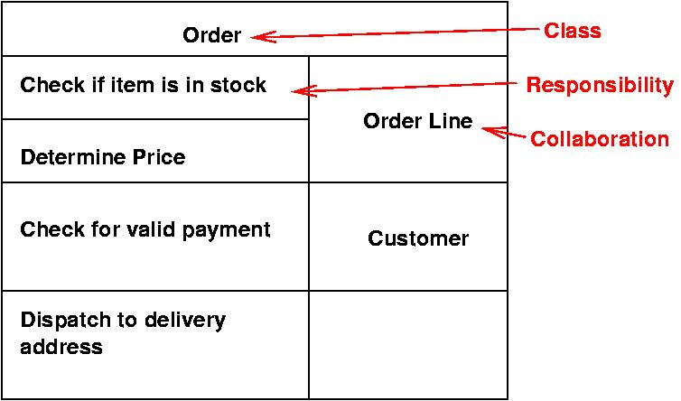



Slide 6
Software Design
Component level design
DFD, sequence diag., state transition diag., class diagram
Interface design
Use case diag., state transition diag. ,sequence diag. , DFDs
Architectural design
Class diagram, CRC, collaboration diag., DFD, control flow diag.
Data / class design
Class diagram, CRC, collaboration diag.

Slide 7
Good Software Design characteristics
Firmness:
Commodity:
Delight:
program should not have any bugs that inhibit its function.
A program must serve the purpose for which it is designed.
The user experience should be pleasurable one.

Slide 8
Characteristics of a good design
the design must implement all of the explicit requirements contained in the analysis model, and it must accommodate all of the implicit requirements desired by the customer.
the design must be a readable, understandable guide for developers & testers.
the design should provide a complete picture of the software, addressing the data, functional, and behavioral domains from an implementation perspective.
All are the ultimate goal of design process

Slide 9
Quality Guidelines
A design should be modular; that is, the software should be logically partitioned into elements or subsystems
A design should contain distinct representations of data, architecture, interfaces, and components.
A design must use appropriate data structures for the classes to be implemented.
A design should lead to components that exhibit independent functional characteristics.
A design should lead to interfaces that reduce the complexity of connections between components and with the external environment.
A design should be derived using a repeatable method
that is driven by information obtained during software requirements analysis.
A design should be represented using an understandable notation

Slide 10
Design Principles
The design process should not suffer from ‘tunnel vision.’
The design should be traceable to the analysis model.
The design should not reinvent the wheel.
The design should “minimize the intellectual distance” [DAV95] between the software and the problem as it exists in the real world.
The design should exhibit uniformity and integration.
The design should be structured to accommodate change.
The design should be structured to degrade gently, even when aberrant data, events, or operating conditions are encountered.
Design is not coding, coding is not design.
The design should be assessed for quality as it is being created, not after the fact.
The design should be reviewed to minimize conceptual (semantic) errors.

Slide 11
Attributes for assessment of design Quality
Functionality ~ assess the capabilities of system & overall security
Usability ~ assess by considering human factors like aesthetics, consistency, documentation
Reliability ~ suggest possible severity of failures, no single point failures are appreciated
Performance ~ assessed using resource consumptions, throughput, process speed, response time
Supportability ~ ability to extend a system, lesser system limitations are good
Maintainability ~ system installation and maintenance should be done easily
Suggested by HP

Slide 12
software design Evolution
Initially modular approach used ~ structured programming
Develop using top-down manner
Later advances and involvement of data structures and reusability and dataflow reshaped it to object oriented programming paradigm.
Now the design approaches are moving for test driven developments

Slide 13
How to make an effective design
Problem partitioning
Define functions, modules and multiple products that could operate separately
Abstraction
Show only the upper level details of the requirements, hide implementation details
As in level 0 of DFD
Top down / bottom up approach used
Top down used for reverse engineering problems -> you have a defined product and you need to customize it as per your needs
Bottom up -> you know modules / subsystems, you integrate them and make up final product

Slide 14
Fundamental Concepts
Abstraction—data, procedure, control
Architecture—the overall structure of the software
Patterns—”conveys the essence” of a proven design solution
Separation of concerns—any complex problem can be more easily handled if it is subdivided into pieces
Modularity—compartmentalization of data and function
Hiding—controlled interfaces
Functional independence—single-minded function and low coupling
Refinement—elaboration of detail for all abstractions
Aspects—a mechanism for understanding how global requirements affect design
Refactoring—a reorganization technique that simplifies the design
OO design concepts—Appendix II
Design Classes—provide design detail that will enable analysis classes to be implemented

Slide 15
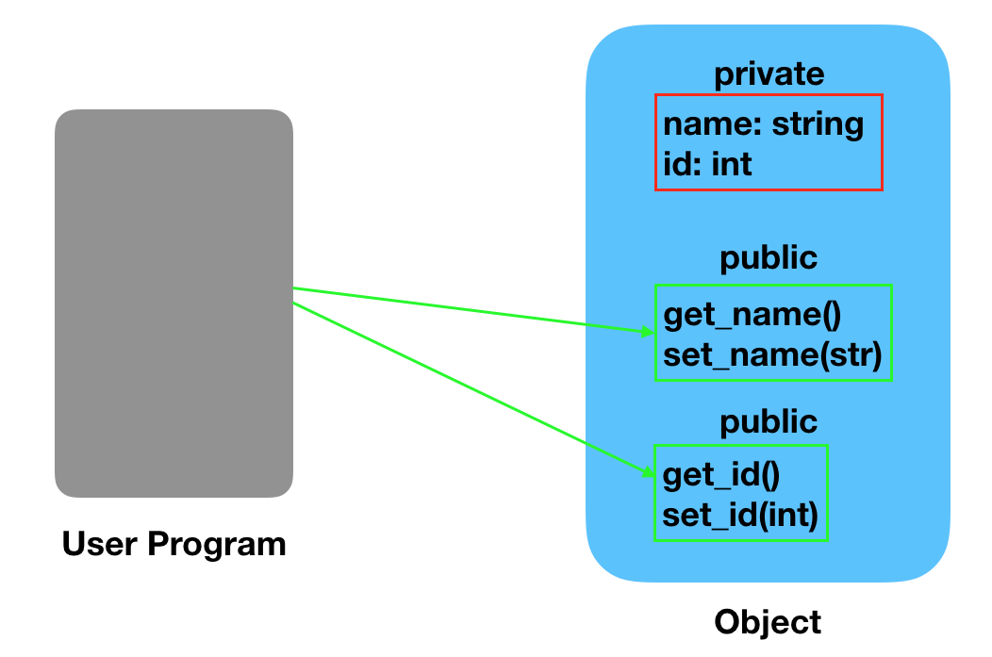
Abstraction
Abstraction
In modular approaches we have multiple level of abstractions
The Higher the level, more the abstraction is
Lower level shows the implementation details
Data abstraction
Procedural abstraction

Slide 16
Data Abstraction
door
manufacturer
model number
type
swing direction
inserts
weight
opening mechanism
implemented as a data structure

Slide 17
Procedural Abstraction
open
details of enter
algorithm
implemented with a "knowledge" of the
object that is associated with enter

